Slide 1
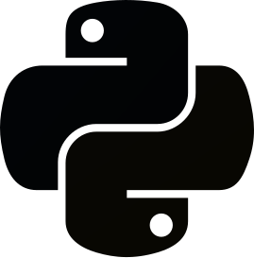
Python Modules

Slide 2
1
Python Modules

Slide 3
Introduction
A module is a file containing a set of functions you want to include in your application.
To create a module just save the code you want in a file with the file extension .py.
Python module index: https://docs.python.org/3/py-modindex.html
Using a module
import myModule as m
m.greeter('Alireza') # Functions
importedName = m.name # Variables
Import from a module
from mymodule import greeter, name

Slide 4
Datetime
Import and use datetime
import datetime
now = datetime.datetime.now()
print(now)
myBirthday = datetime.datetime(1999, 1, 5)
print(myBirthday.strftime('%x'))
print(myBirthday.strftime('%A'))
print((now - myBirthday).days)

Slide 5
Math
Import and use math
import math
print(math.sqrt(64))
print(math.ceil(1.4))
print(math.floor(1.4))
print(math.pi)

Slide 6
JSON
JSON is a syntax for storing and exchanging data.
Import and use math
import json
myJson = '{ "name": "Alireza", "age": 24}'
myDict = json.loads(x)
myDict['age'] = 29
anotherJson = json.dumps(x)
String
Number
Array
str
int
float
list
tuple
Object
Boolean
Null
dict
bool
NoneType

Slide 7
Packages
A package contains all the files you need for a module.
PIP is a package manager for Python packages, or modules if you like.
Python package index: https://pypi.org/
Download a package
pip install numpy
Remove a package
pip uninstall numpy
List packages
pip list

Slide 8
Thanks!
You can find me at:
github.com/AleeRezaa
t.me/Alee_Rezaa
alee_rezaa@outlook.com

